Slide 1
Terrain specifications and guidelines

Slide 2
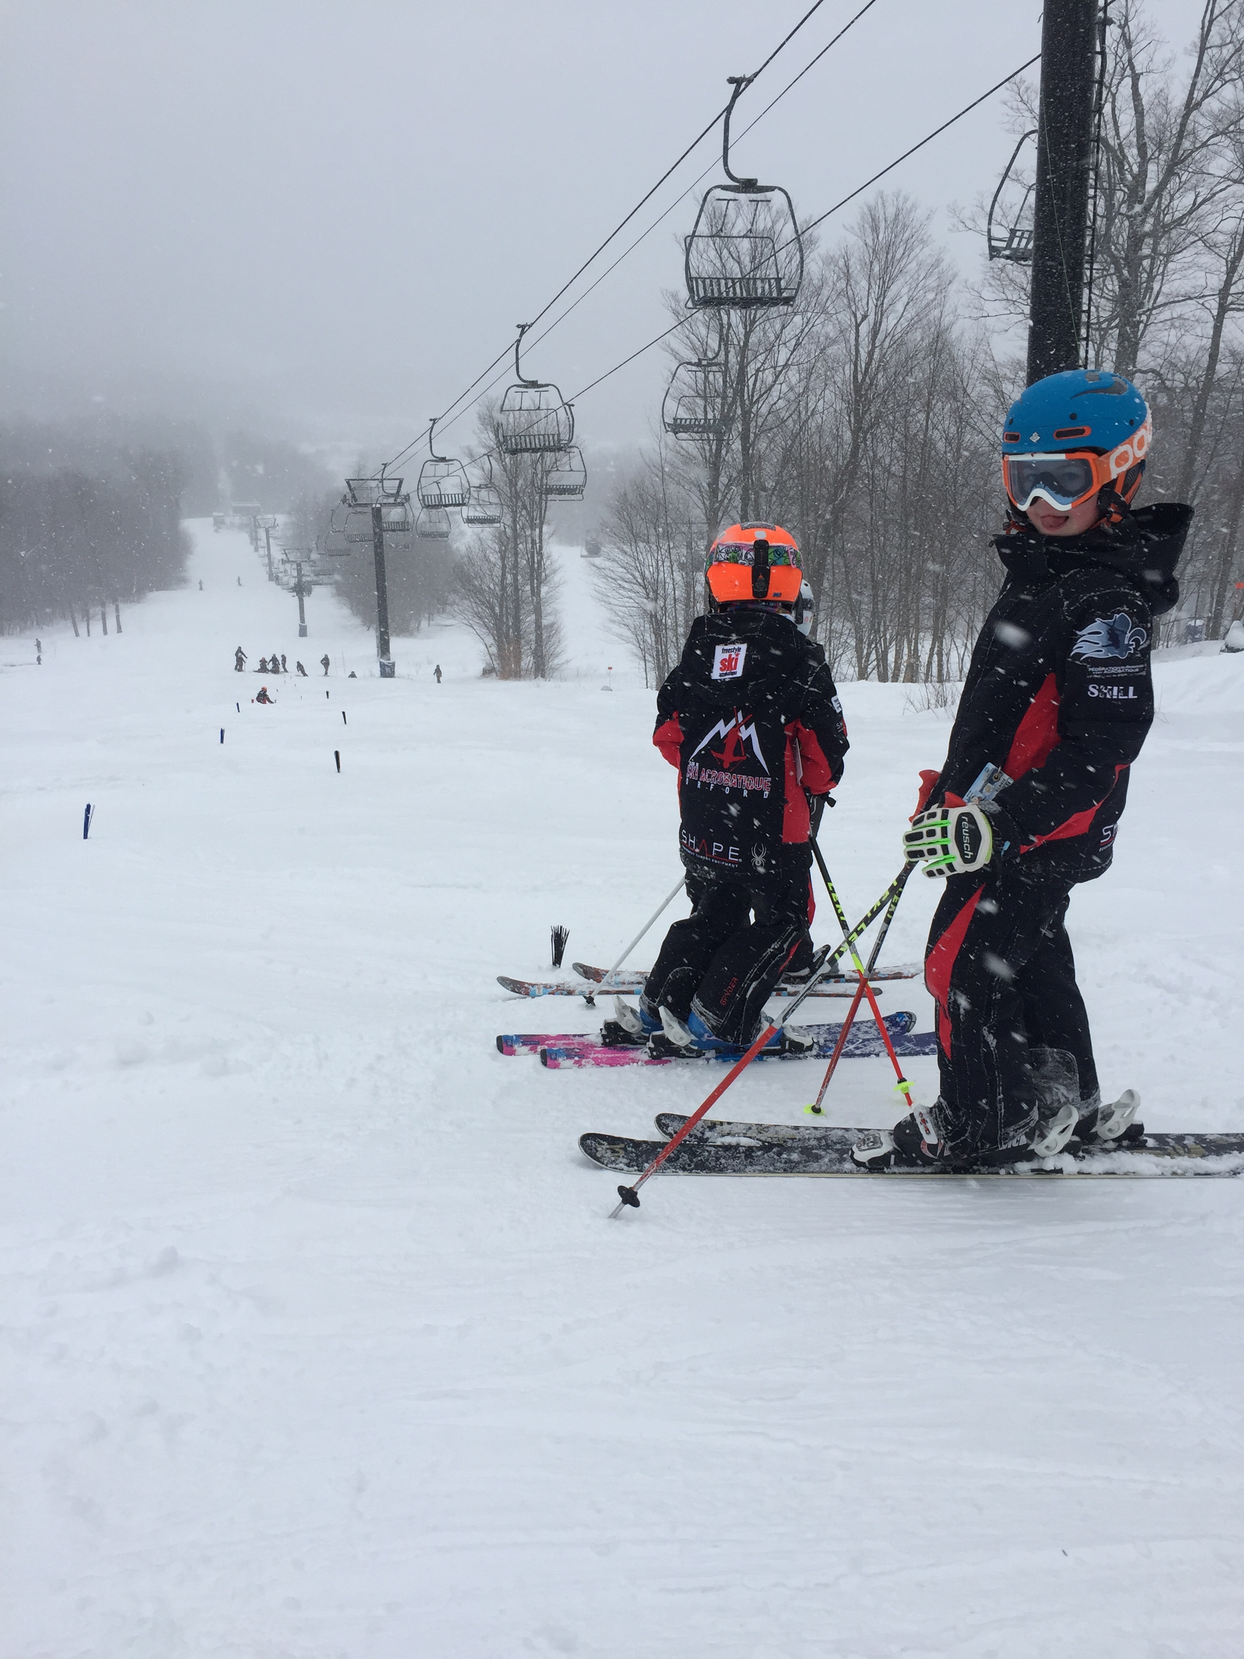
Brushie Slalom
Pick an intermediate slope
Set about 10 brushes with 7m length by 3m width between each others
Approximately 100m

Slide 3
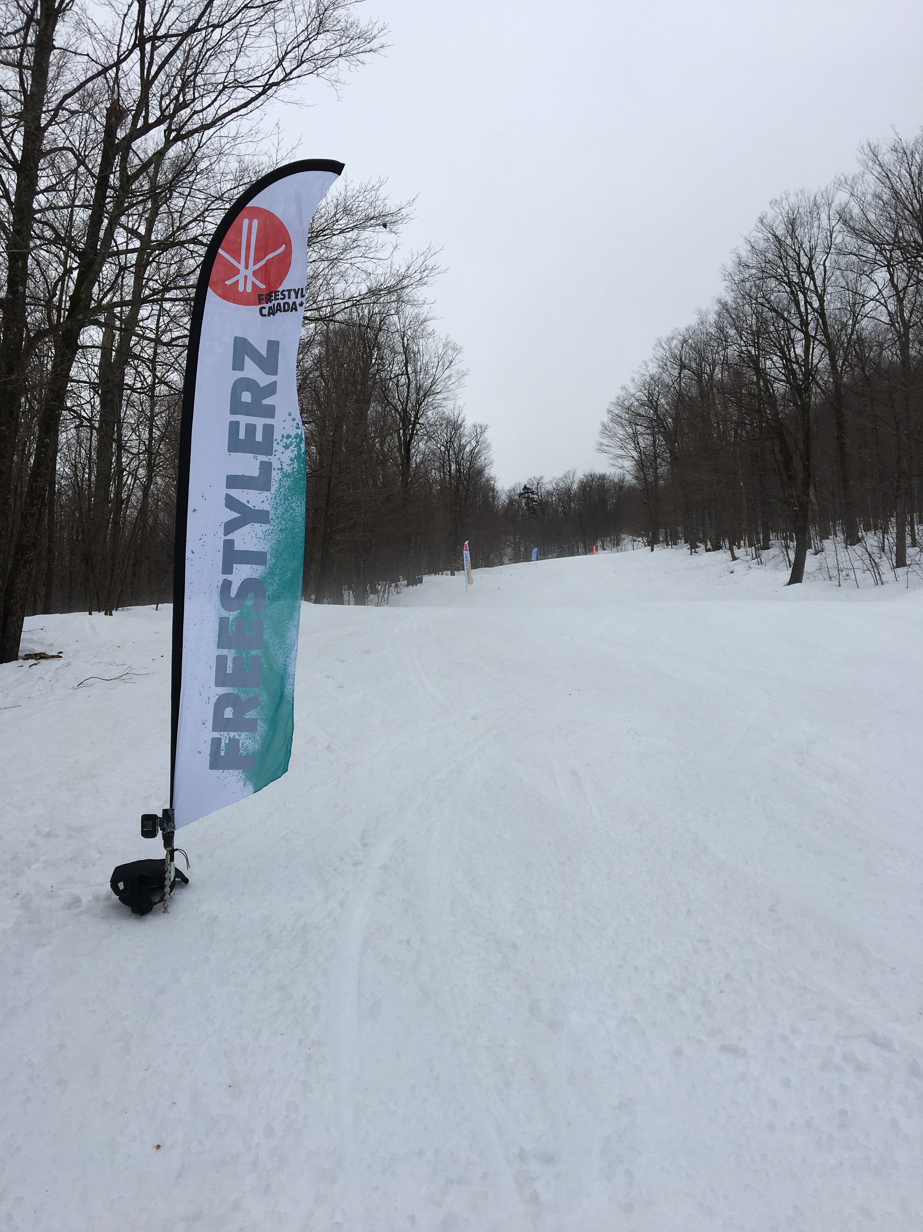
The Switch
Pick an intermediate slope
Set a start gate and a finish line separated by 100m
Try to keep the snow as flat as possible

Slide 4
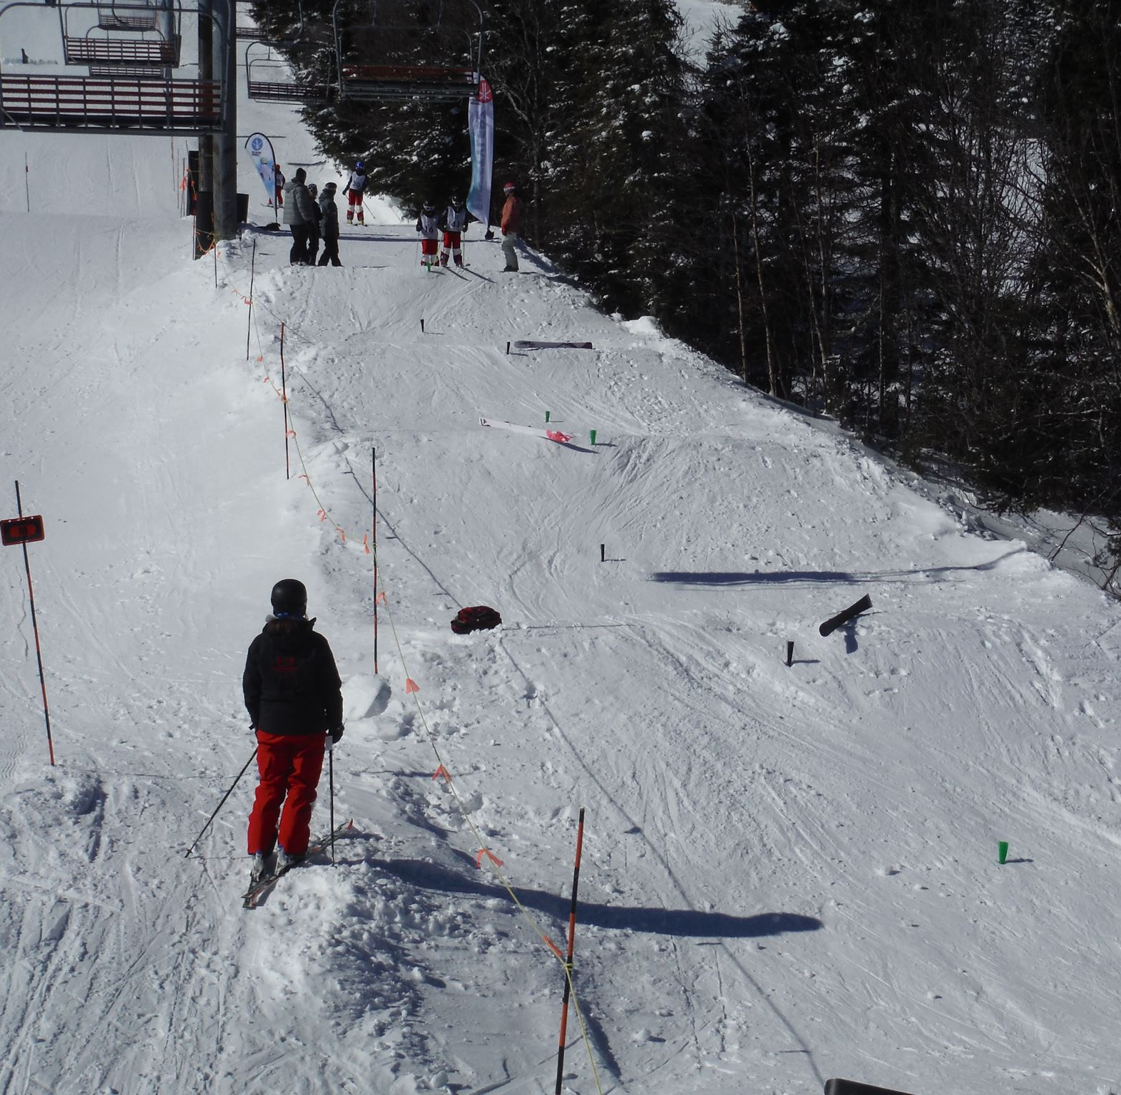
The Roller Tank
These rollers will be used for both the absorption and turn timing skills
Set rollers every 6-7 m
Every roller should be about a meter high
Build them with a cat on a beginners terrain (a double cat blade width is ideal?)
Finish the shaping with a shovel and some side slipping

Slide 5
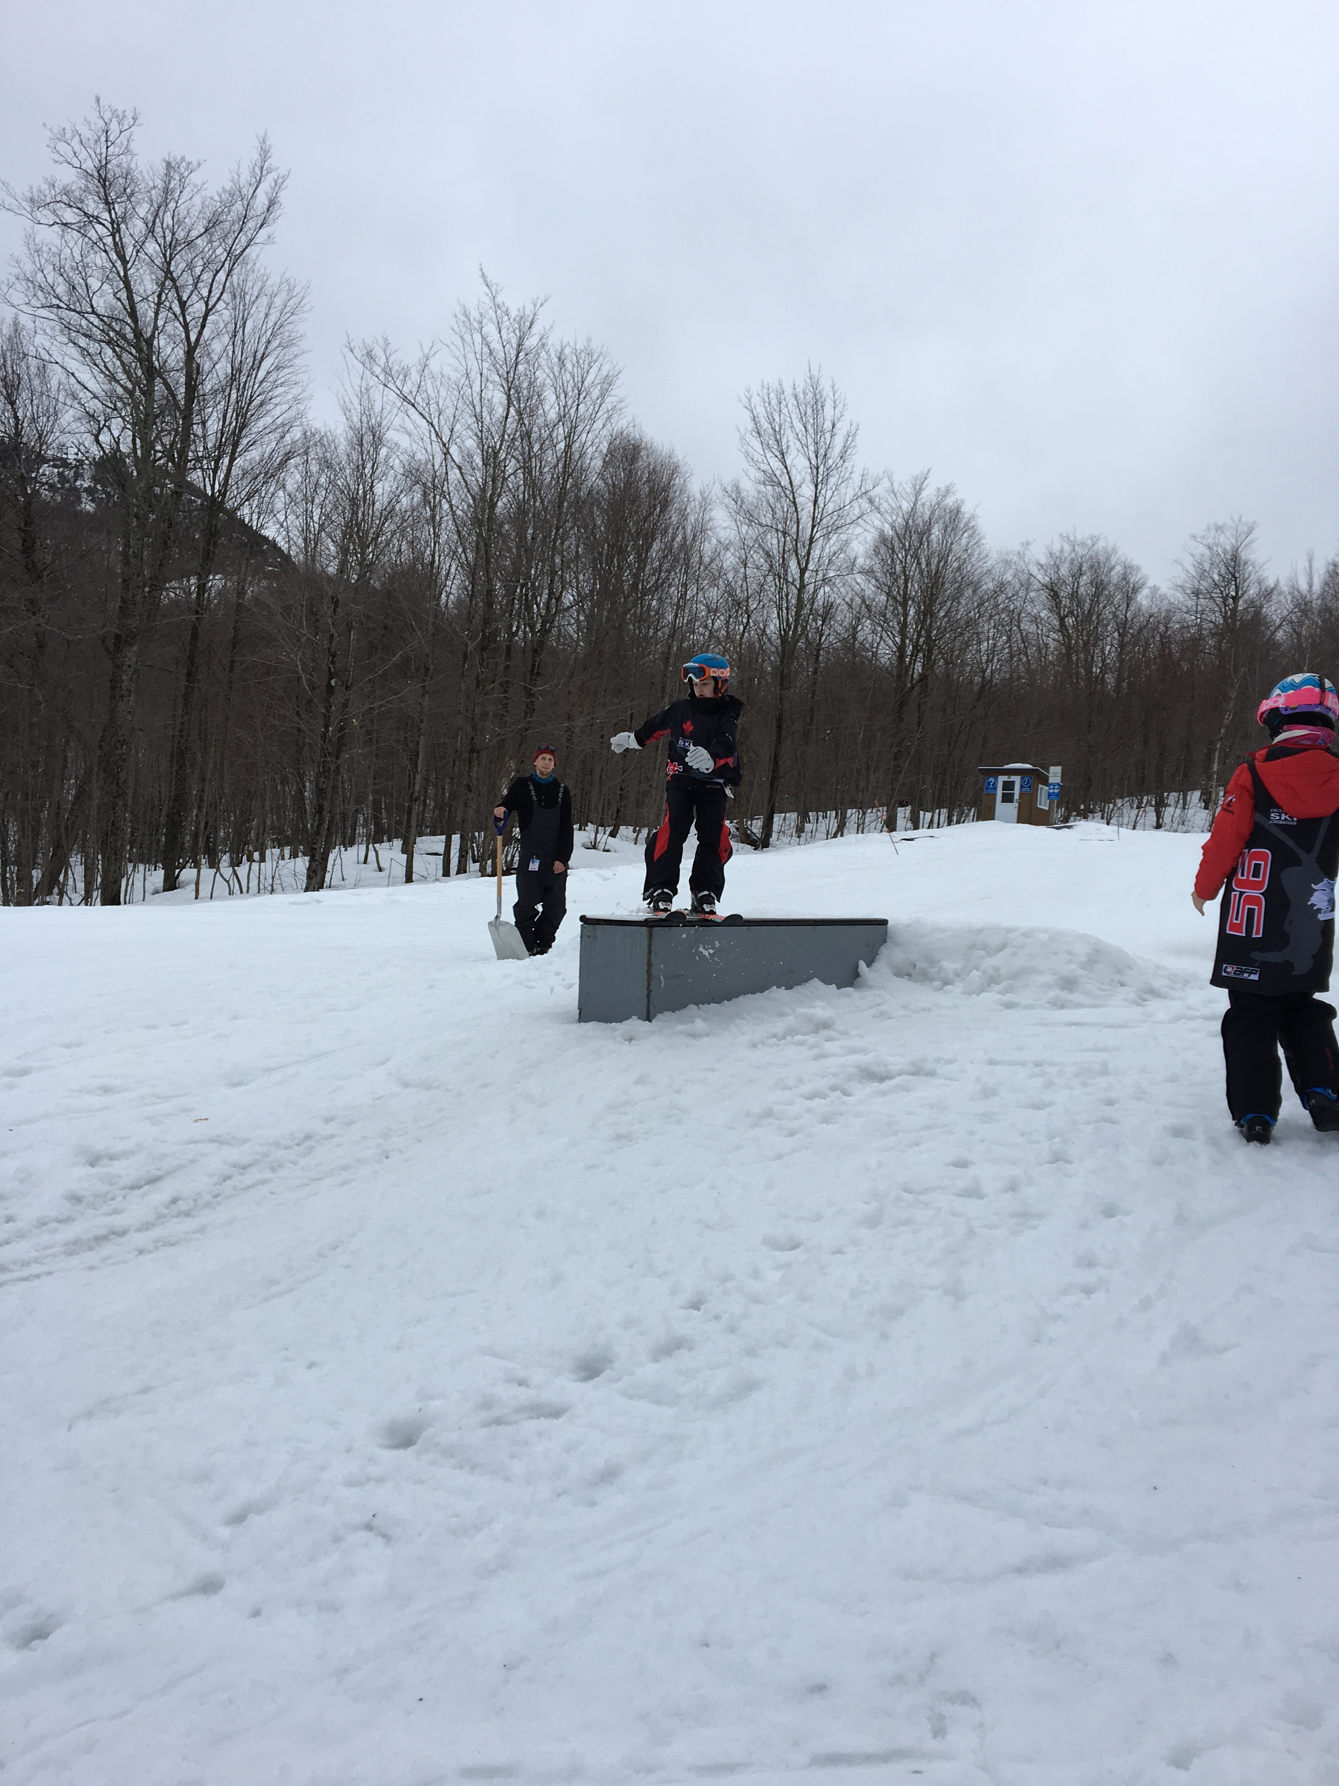
The Box
Pick a beginners run
Set a 10m in run and out run
Set a +/- foot wide 12’ box
Make it +/- than a foot from the ground
Make sure there is no gap between the lip and the module
If needed for a higher DD, set a strait X rail with the same specs

Slide 6
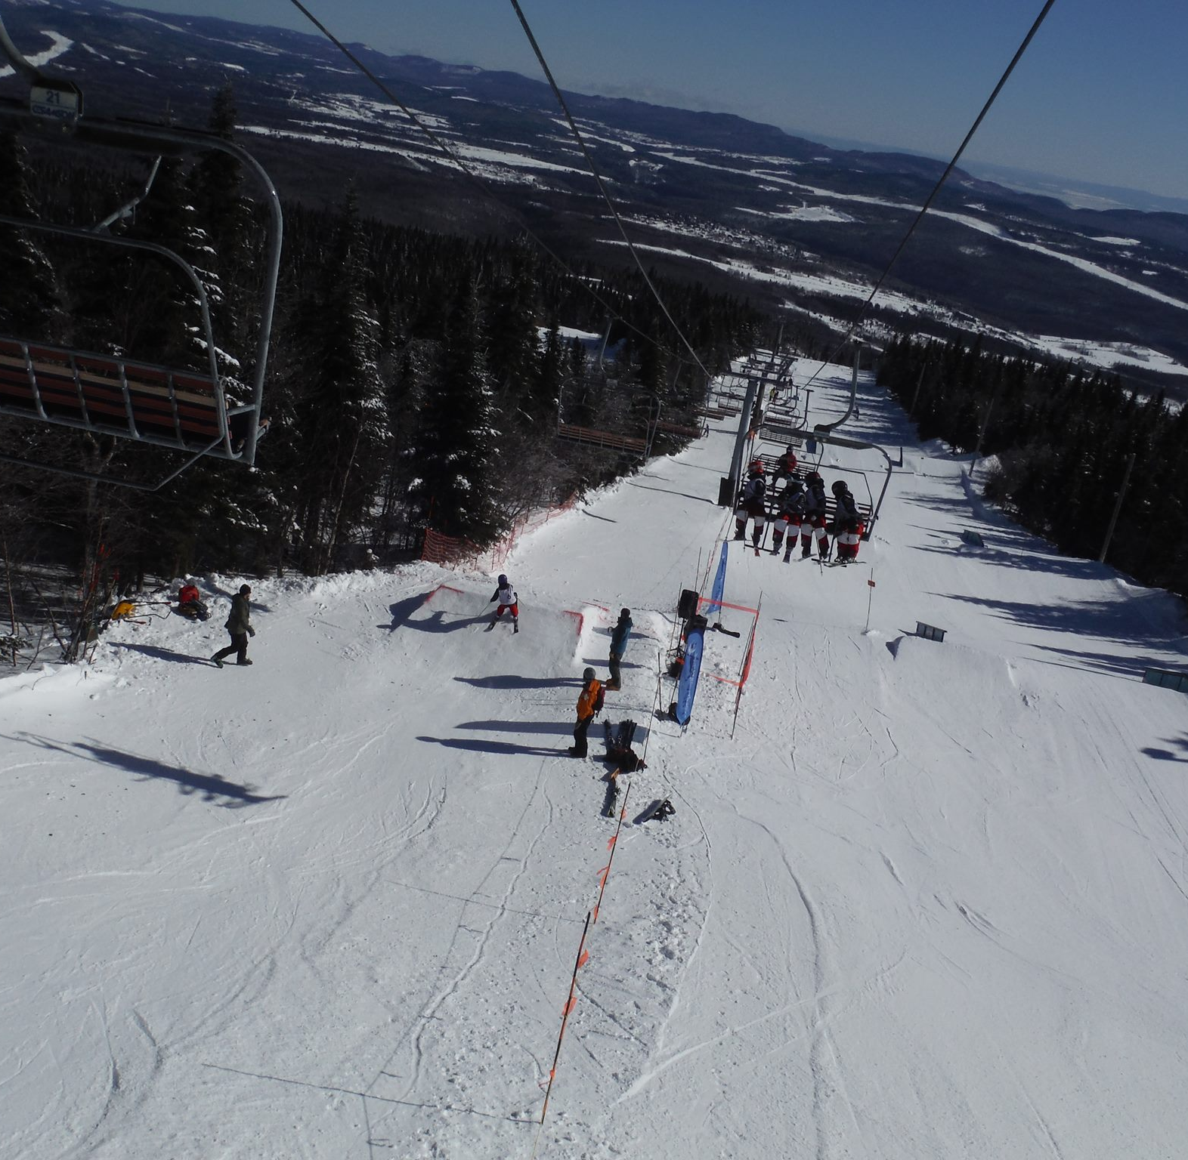
The Air Show
Set a 15m x 15m in run between 20°-30°
Build a 15m x 15m relatively flat table
Build a 15m x 15m landing between 35°-40°
Set 2 different take offs
  A 1m take off at 2 from the knoll
  A 1,5m take off at 4m from the knoll
  Shape your take offs between 27°-32°
Make sure the back of the smaller take off is filled with snow for safety and to increase athlete’s confidence
Chop and step the landings as needed

